Slide 1
Digital Portfolio
STUDENT NAME: PETESHYA P
REGISTER NO AND NMID: 2428C0497 & 29E42A79BA976E0B3444036CE2E55B0B
DEPARTMENT: B.Sc - AIML
COLLEGE: KPR COLLEGE/ BHARATHIYAR UNIVERSITY

Slide 2
PROJECT TITLE
A Personal Photography Portfolio Website.

Slide 3


AGENDA
Problem Statement
Project Overview
End Users
Tools and Technologies
Portfolio design and Layout
Features and Functionality
Results and Screenshots
Conclusion
Github Link
3/21/2024 Annual Review

Slide 4

PROBLEM STATEMENT
Photographers often struggle to showcase their work effectively, as a traditional resume fails to reflect their creative skills visually, while relying solely on social media can appear unprofessional and fail to impress potential clients. Without a proper, well-organized portfolio, it becomes difficult to stand out in a competitive industry, attract new opportunities, and as a result, many talented photographers miss valuable chances simply because they lack a clear, professional platform to represent their work.

Slide 5

PROJECT OVERVIEW
About Me: A short introduction about myself and my passion for photography. Skills: Photography techniques, editing, and creativity in capturing moments. Portfolio/Gallery: Collection of my best photos showing different styles. Experience: Work done for clients, events, or freelance projects. Contact: Easy ways to reach me for bookings or inquiries.

Slide 6

WHO ARE THE END USERS?
Clients looking to hire photographers for events, portraits, or commercial work.
Agencies/Brands searching for photographers to collaborate on campaigns or product shoots.
Photography Enthusiasts who want to explore creative styles and get inspiration.
Event Organizers checking a photographer’s past work before hiring.
Recruiters/Studios in the creative industry looking for skilled photographers.

Slide 7

TOOLS AND TECHNIQUES
HTML CSS JavaScript Git and GitHub VS Code

Slide 8
POTFOLIO DESIGN AND LAYOUT
Home (big photo or slideshow) About Me (bio, style, awards) Portfolio (photos in groups: weddings, portraits, travel) Services (what you offer) Contact (easy booking) Works on phone and computer Clean look: simple colors, clear fonts Extra: reviews, Instagram feed, blog
8

Slide 9
FEATURES AND FUNCTIONALITY
Navigation bar with smooth scroll Projects shown with images and info Interactive parts Contact form to get in touch Works well on all devices Light and dark mode for better user experience.

Slide 10
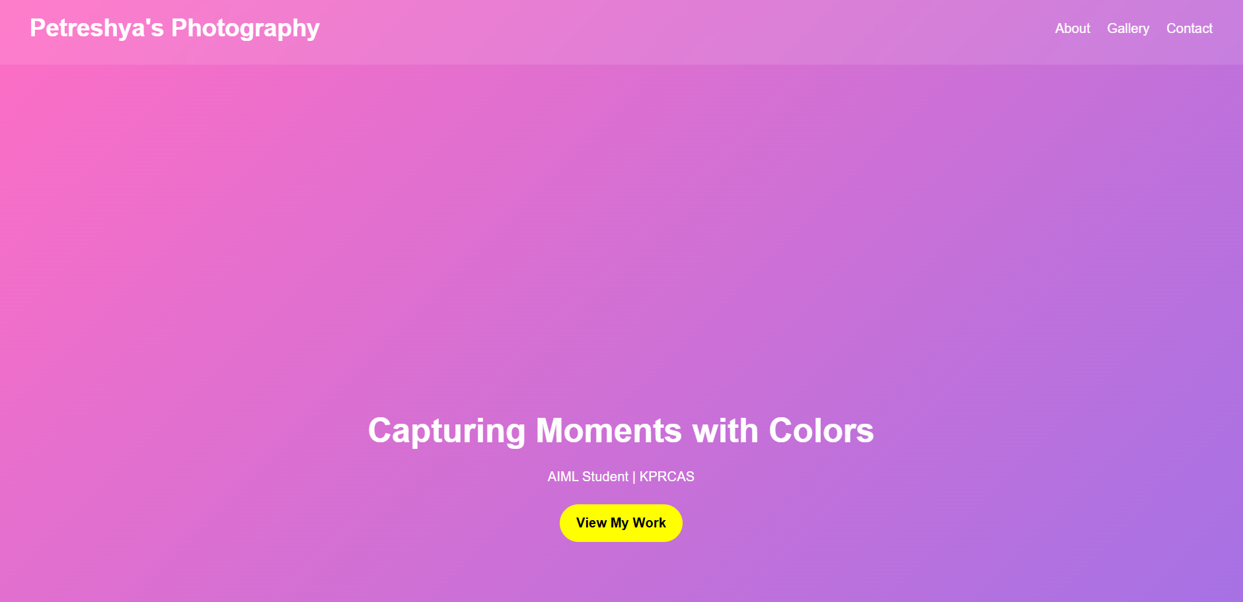

RESULTS AND SCREENSHOTS
3/21/2024 Annual Review
10

Slide 11
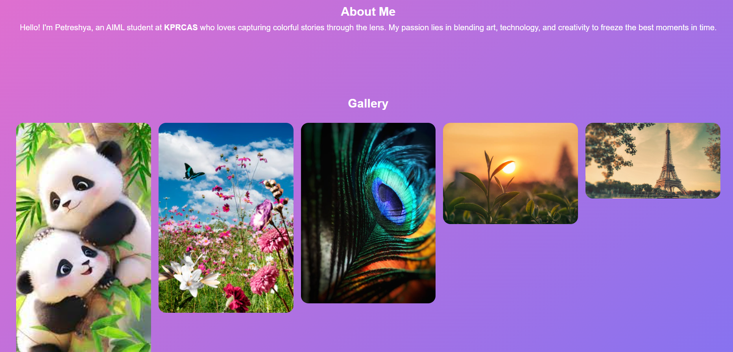
RESULTS AND SCREENSHOTS
3/21/2024 Annual Review
11

Slide 12
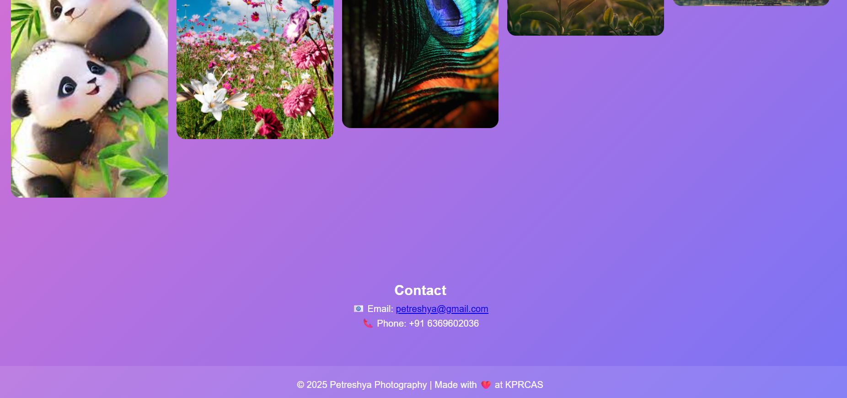
RESULTS AND SCREENSHOTS
3/21/2024 Annual Review
12

Slide 13
GITHUB LINK
https://github.com/petreshya

Slide 14
CONCLUSION
Showcases my best photographs and creative style. Summarizes my journey, achievements, and photography experience. Helps clients easily understand the type of shoots I offer. Makes it simple for clients, agencies, and collaborators to contact or book me. Builds a professional online presence that helps me stand out in the photography industry.
14

